Slide 1

Augmented Reality Based Mobile Application for Electrical Laboratory Experiment
Presented by
Moythry Manir Samia ID: 11609015 Reg.No.: 11609015 Session: 2015-16 Dept. of ICT

Slide 2







CONTENTS
Contents | Slide No.
Introduction | 3
Relative works | 10
Project overview | 7
Requirements | 13
Theories | 16
Project implementation | 22
Result | 36
Conclusion | 50
Future scopes | 51
References | 52

Slide 3
INTRODUCTION

Slide 4

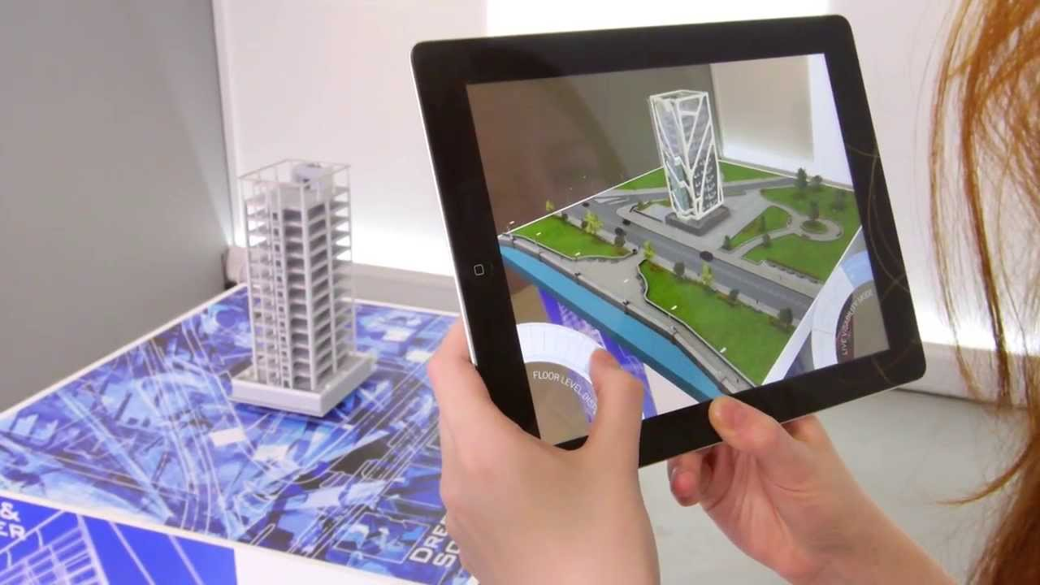
Augmented Reality
Augmented Reality (AR) is a modern technology that can blend graphical simulations like 3D objects, video, audio with the real world in real time.

Slide 5

Fields of AR
Education
Healthcare
Automotive
Manufacturing
Gaming
Fashion & Beauty Industry

Slide 6

AR in Education
Create interactive learning environment
Efficient way of teaching
Scope for visualization
Make topics interesting
Tool for distance learning

Slide 7
Project Overview
An AR based low-cost simulator mobile application for electrical lab experiment.
Simulates experiments with virtual equipment that imitate real world.
It contains five fundamental experiments:
- Ohm’s law,
- Superposition Theorem,
- Thevenin’s Theorem,
- Norton’s Theorem,
- Reciprocity Theorem.

Slide 8

Motivations
Upgrade learning concept
Reduce the risk of physical damage of the devices in the laboratory by giving prior knowledge to amateurs.
Decrease rate of accidents in laboratory.
Lessen time and cost.
An amazing tool for distance learning.

Slide 9

RELATED WORKS

Slide 10

A project AR Globe has been developed by Mayilyan. It uses a physical globe as marker and presents general information about the earth in 3D format through smart device shown in fig. 1 [1].
From 2011-2016, a SSCI-indexed journals was published by Chen, Liu, Cheng & Huang reflecting properties, benefits, potency of AR in educational field [2].
Fig.1: View of AR Globe.

Slide 11
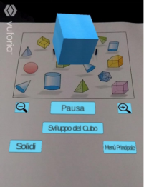
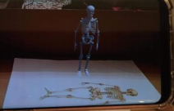
An application for displaying geometric solids using AR has been developed by Cazzolla, Lanzilotti, Roselli, and Rossano [2] shown in fig. 2.
An educational AR application for elementary school students focusing on human skeleton has been developed by Kouzi, Mao and Zambrano [3] shown in fig. 3.
Fig. 2: View of geometric solids
Fig. 3: View of educational app for elementary school.

Slide 12


REQUIREMENTS

Slide 13

Hardware requirements
Processor : Core i3 2.40 GHZ
RAM : 4GB
Hard Disk : 750 GB
Monitor : 18”LCD monitor
Keyboard : 122 keys

Slide 14


Software Requirement
Vuforia SDK in Unity 3D
Unity 3D is a cross-platform game engine. Vuforia is an augmented reality software development kit (SDK) for mobile devices that enables the creation of augmented reality applications.
Blender 3D
Blender is an open-source 3D computer graphics software toolset used for creating animated films, visual effects, 3D printed models, motion graphics, interactive 3D applications, virtual reality, and computer games.

Slide 15

THEORIES

Slide 16
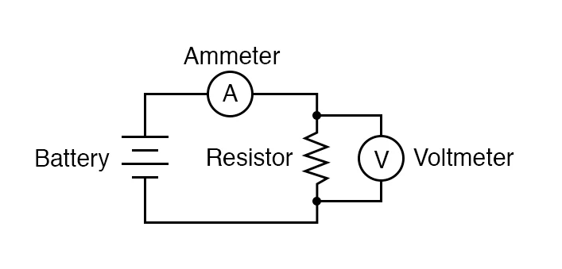
Ohm’s Law
Ohm’s law states that current flow between two points of a conductor is directly proportional to potential difference across those points when all physical conditions and temperature remain constant. Resistance is the constant of proportionality in Ohm’s law. In mathematical form, Ohm’s law can be expressed as:
V=IR
17

Slide 17
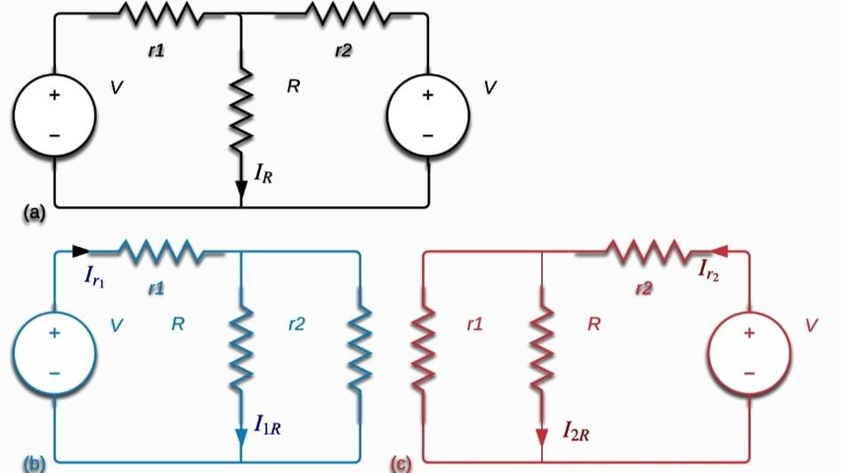
Superposition Theorem
The superposition theorem states that if a branch of a linear circuit has multiple independent sources, the response of that branch equals the algebraic sum of the responses of each independent source acting alone.
In fig.2, current I1 is flowing through (a) circuit and I2 through (b). According to Superposition theorem in (c)
I = I1+ I2
Fig. 5: Circuit diagram of Superposition theorem.

Slide 18
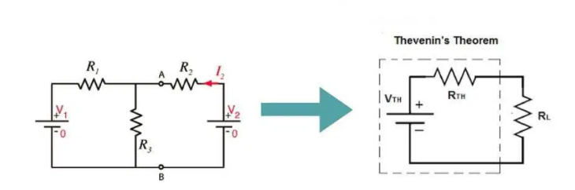
Thevenin’s Theorem
Thevenin’s theorem states that any linear circuit can be simplified by replacing it with an equivalent circuit containing a voltage source and resistance connected in series with a load.
Thevenin equivalent circuit is built by V_{TH}, R_{TH} which are calculated from original circuit. Current in thevenin circuit,
I_{L} =V_{TH}/(R_{TH}+R_{L})
Which is equal to current in original circuit.
'
Fig. 6: Circuit diagram of Thevenin theorem.

Slide 19
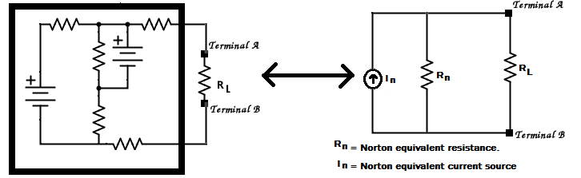
Norton’s Theorem
Norton’s theorem states that any linear circuit can be simplified by replacing it with an equivalent circuit containing a current source and resistance connected in parallel with a load. Norton circuit is built with I_{N} and R_{N} calculated from original circuit. Load current in Norton circuit,
I_{L} = I_{N} ( R_{N}/(R_{N}+R_{L})
Which is equal to current of original circuit.
Fig. 7: Circuit diagram for Norton’s theorem.

Slide 20
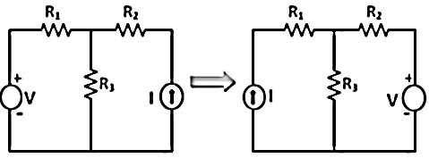
Reciprocity Theorem
The reciprocity theorem states that in a reciprocal circuit, if voltage source V in one branch generates a current I in another one, then if the voltage source is replaced from the first one to the second branch, it will generate the same current in the first branch, where the source was placed originally. If current in initial circuit is I₁ and after alteration of voltage source location, if current is I₂, then
I₁=I₂
Fig. 8: Circuit diagram for Reciprocity theorem

Slide 21

PROJECT IMPLEMENTATION

Slide 22
STEPS OF APPLICATION DEVELOPMENT
Create a new project in Unity 3D
Add Vuforia SDK and android plugin in Unity 3D
Create database of image target in Vuforia portal
Import 3D models and Vuforia database in the unity project
Scene implementation
Animation and UI design
Application building for android mobile
Taking user input using UI buttons
Result shown on the targeted image based on users choice

Slide 23
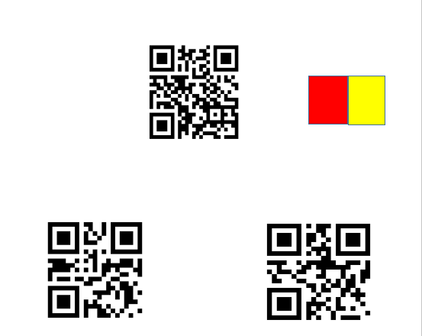
Image Target Selection
An image target is needed to trigger the simulation through mobile camera.
Fig. 9 is selected as the image target of the project.
Fig. 9: Image target of project.

Slide 24

Creating 3D objects & database
Simulating 3D objects needed for the project using Blender 3D.
Creating database of image target and Vuforia key in Vuforia site.

Slide 25
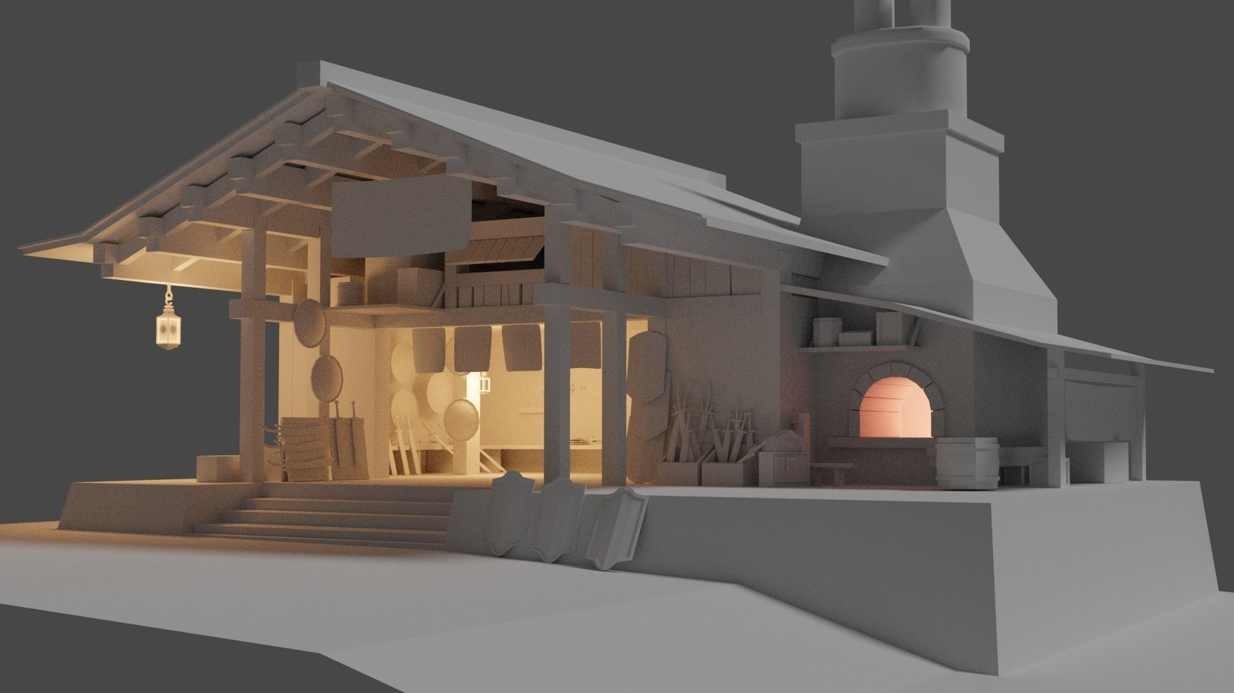
3D MODELS

Slide 26
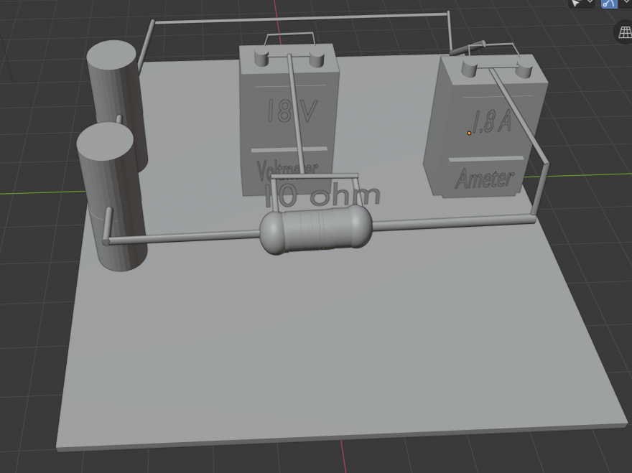
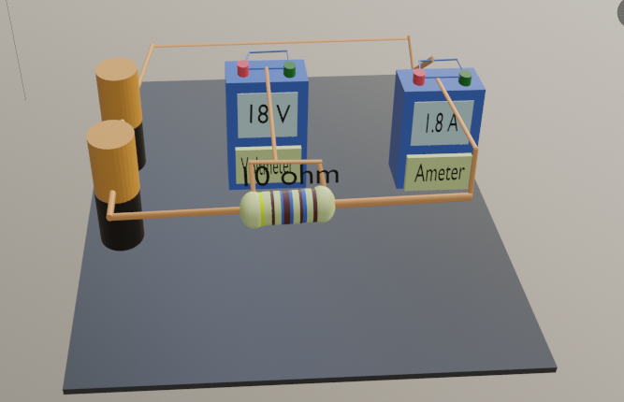
Circuit model & texturing of Ohm's law.

Slide 27
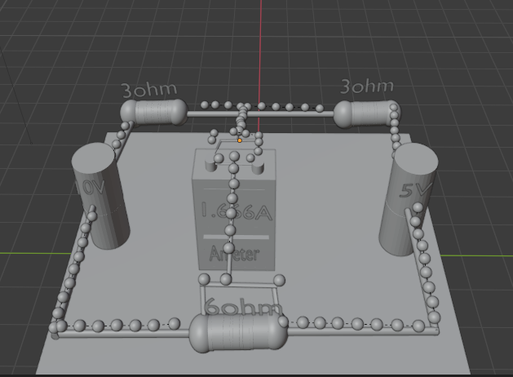
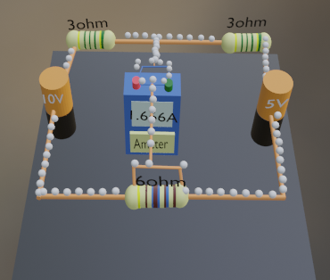
Circuit model & texturing of Superposition theorem.

Slide 28
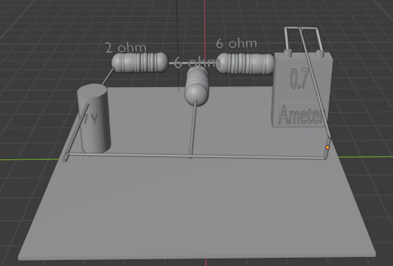
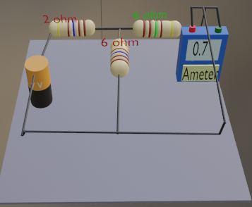
Circuit model & texturing of Thevenin’s theorem.

Slide 29
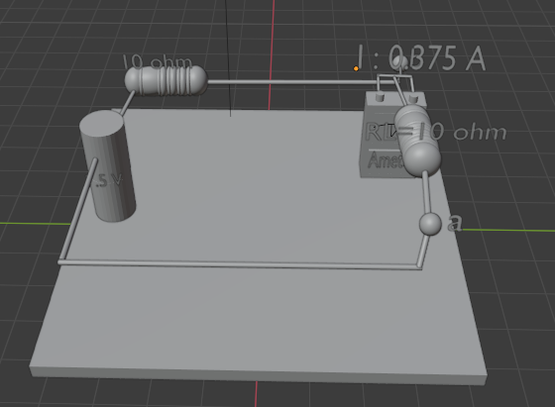
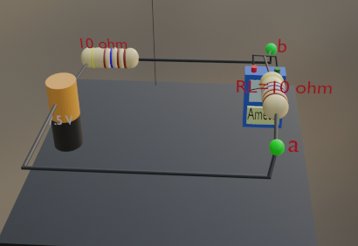
Circuit model & texturing of Norton's Theorem.

Slide 30
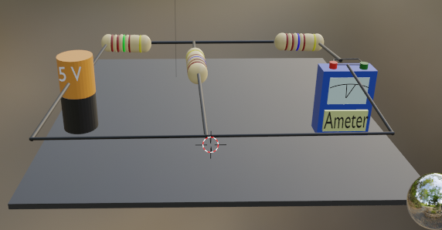
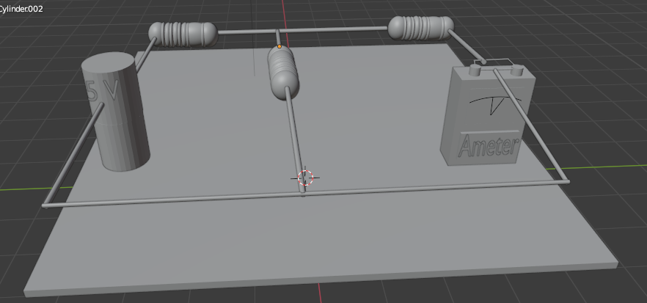
Circuit model & texturing of Reciprocity theorem.

Slide 31
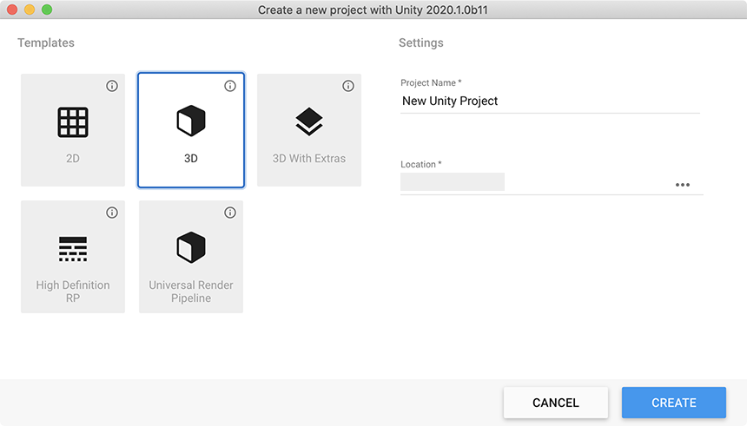
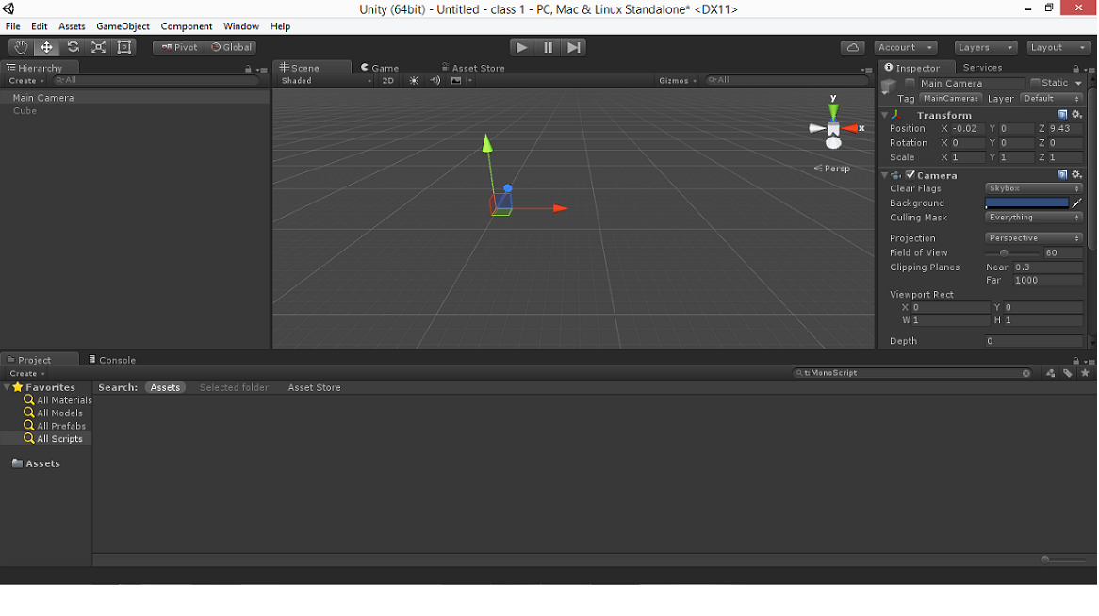
Creating Project in Unity 3D and Scene Implementation
Creating a new project in Unity.
Pasting Vuforia developer key.
Importing database from Vuforia.
Exporting 3D models from Blender 3D to Unity in asset folder.
Designing the scenes.
32

Slide 32
UI Design
1
2
3
Adding a game object called canvas.
Adding panel and buttons to canvas.
Writing C# scripts for UI functions.

Slide 33
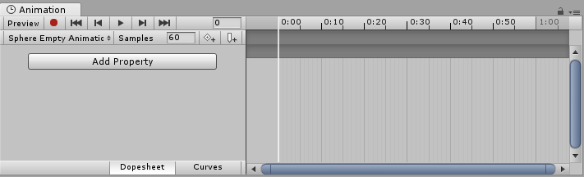
Adding Animation
In animation window, creating animation clip.
Recording desired movement of the object in the clip.
Adding C# scripts for activating animation.

Slide 34
Application Building
In build setting, choosing platform as android
Adding all scenes in build setting
Building APK
Transfering APK in android mobile

Slide 35
RESULT

Slide 36
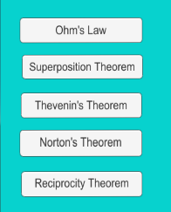
Menu Bar for Experiments
User can choose desired experiment from the menu bar.

Slide 37
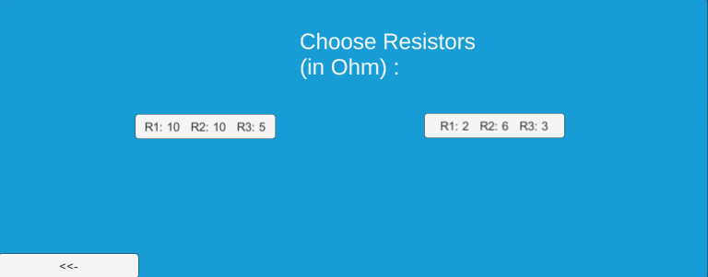
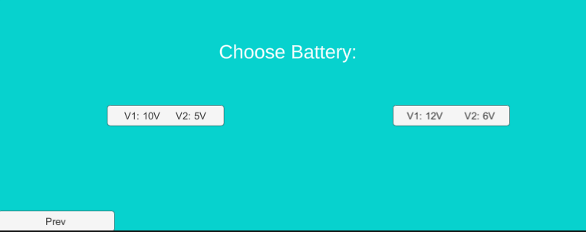
UI for Resistor & Battery Value

Slide 38
Ohm's Law
Table 2: Data table for verifying Ohm’s law.
Experiment No. | V1 (single battery) | I1 | V2 (two batteries) | I2 | V3 (three batteries) | I3
1 | 9V | 0.9A | 18V | 1.8A | 27V | 2.7A
2 | 12V | 1.2A | 24V | 2.4A | 36V | 3.6A
3 | 8V | 0.8A | 16V | 1.6A | 24V | 2.4A
User can choose battery value from 9V, 8V & 12V.
A 10 ohm resistor is used in the experiment.
Table 2 verifies Ohm’s law, as current is proportional to voltage value.

Slide 39
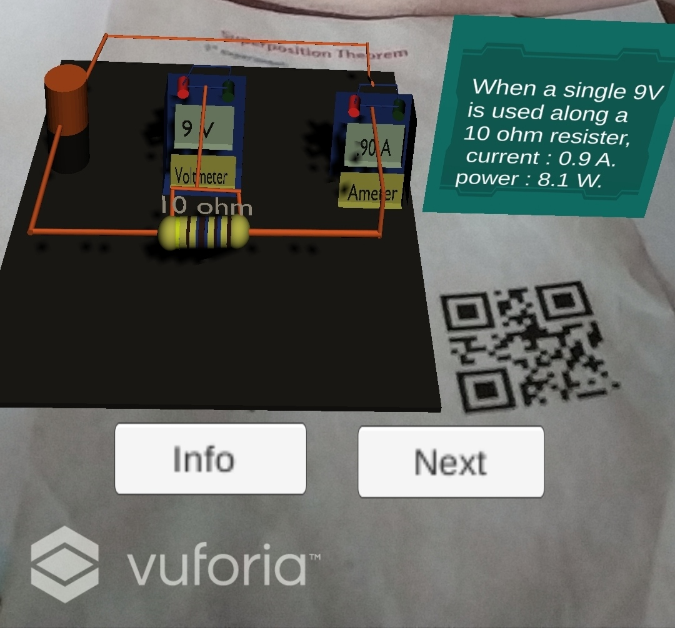
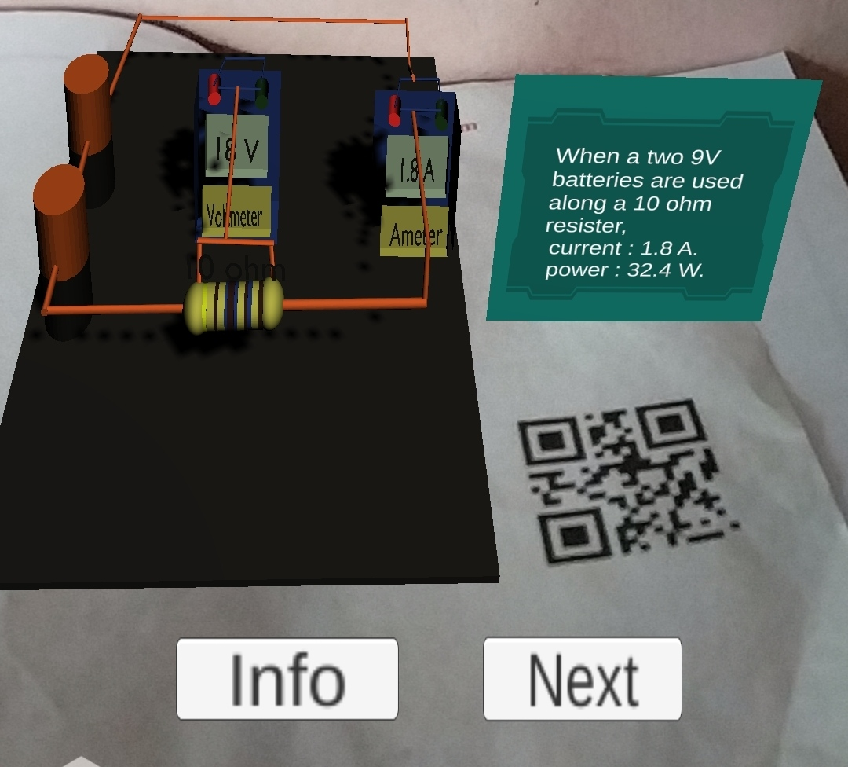
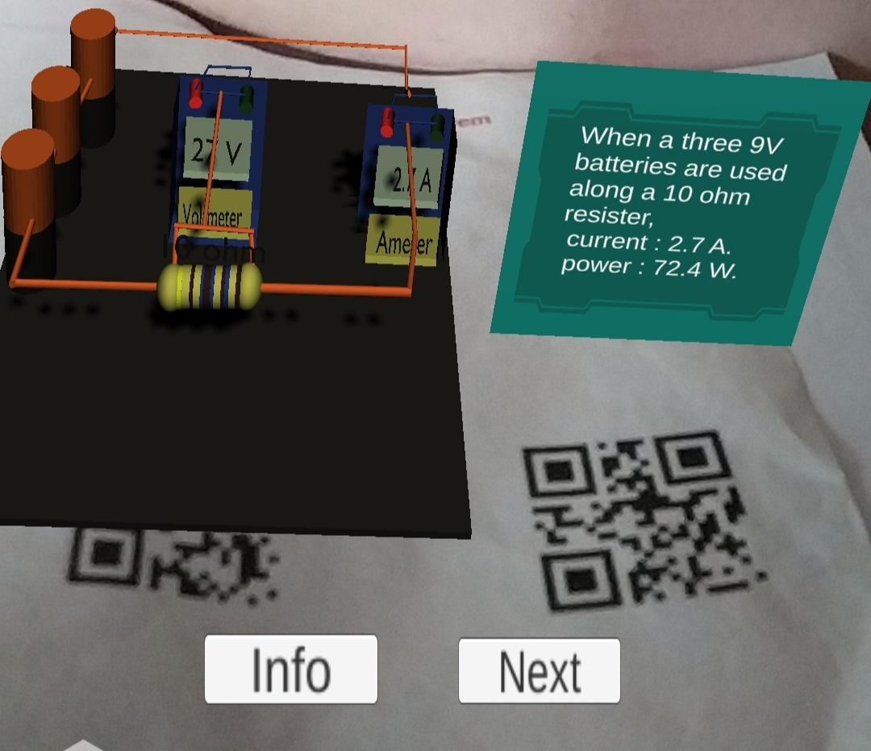
View of experiment 1 of Ohm’s law

Slide 40
Superposition Theorem
Table 3: Data table verifying Superposition Theorem
Experiment No. | V1 | V2 | R1 | R2 | R3 | I1 | I2 | I
1 | 10V | 5V | 10Ω | 10Ω | 5Ω | 0.75A | 0A | 0.75A
2 | 10V | 5V | 3Ω | 3Ω | 6Ω | 2.00A | -0.33A | 1.67A
3 | 20V | 9V | 3Ω | 3Ω | 6Ω | 3.49A | -0.72A | 2.78A
4 | 20V | 9V | 10Ω | 10Ω | 5Ω | 0.45A | 10Ω | 0.3A
Users can choose either batteries of 10V and 5V or 20V and 9V.
For resistors, there are two options for users, R1=10Ω, R2=10Ω and R3=5Ω or R1=3Ω, R2=6Ω and R3=3Ω.
Table 3 verifies Superposition theorem

Slide 41
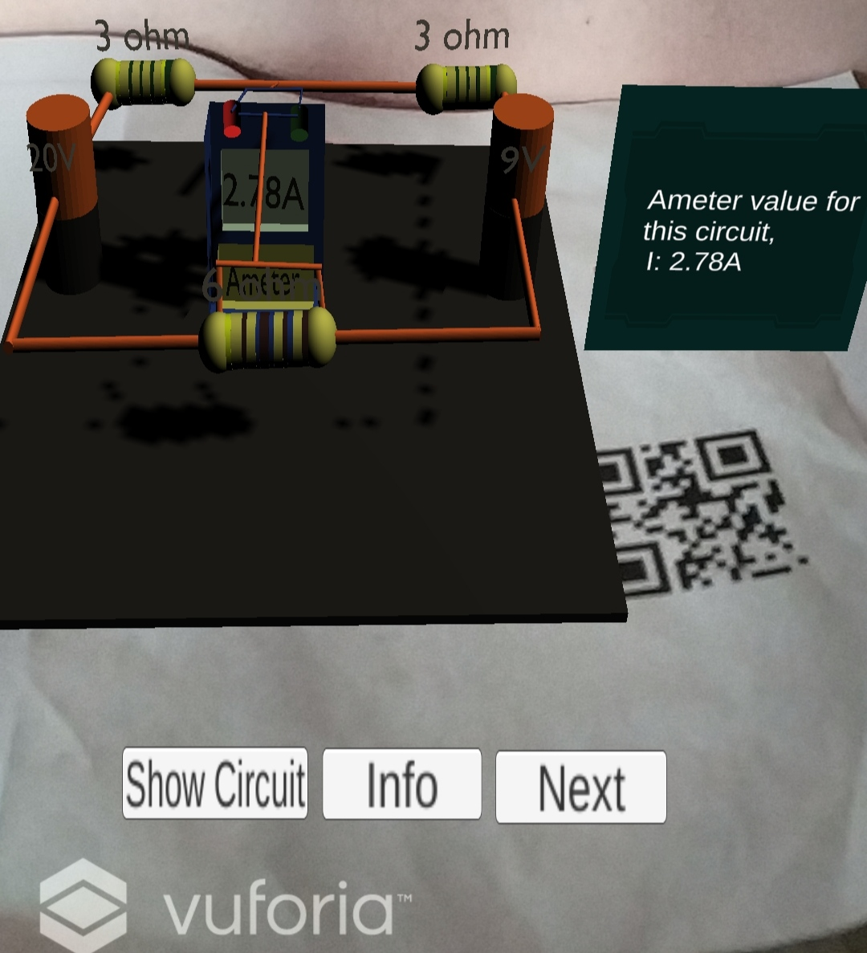
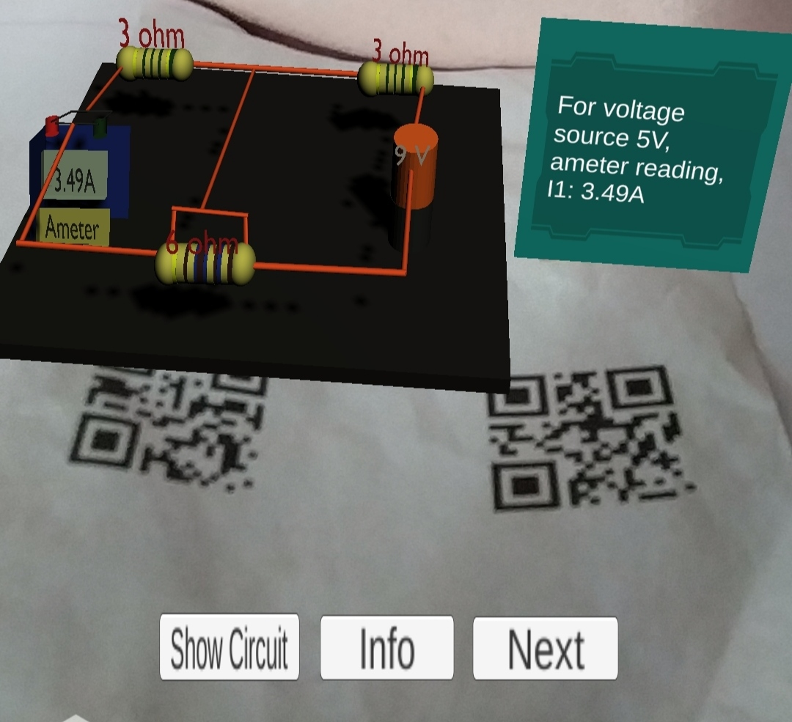
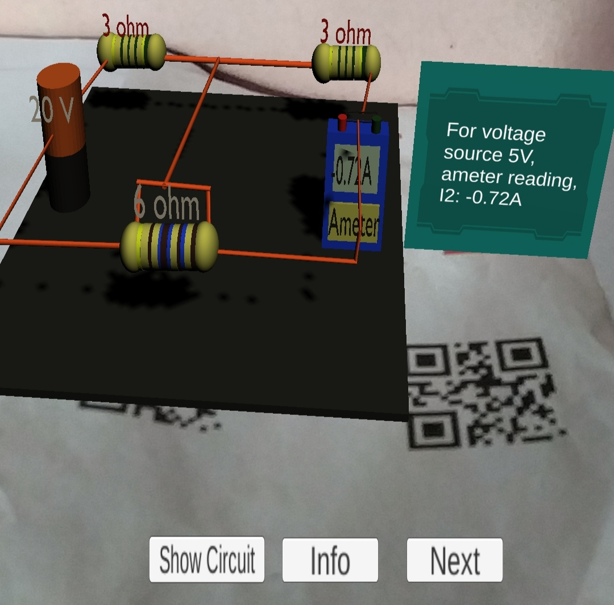
View of experiment 3 of Superposition theorem

Slide 42
Thevenin’s Theorem
Table 4: Data table for verifying Thevenin’s theorem.
Users can choose either batteries of 10V and 5V or 12V and 6V.
For resistors, there are two options for users, R1=10Ω, R2=10Ω and R3=5Ω or R1=3Ω, R2=6Ω and R3=3Ω.
Table 4 verifies Thevenin’s theorem
Experiment No. | V1 | V2 | R1 | R2 | R3 | I1 | Rth | Vth | I2 (Thevenin circuit)
1 | 10V | 5V | 10Ω | 10Ω | 5Ω | 0.375A | 10Ω | 7.5V | 0.375A
2 | 10V | 5V | 3Ω | 3Ω | 6Ω | 0.604A | 4.5Ω | 10.5V | 0.604A
3 | 12V | 6V | 3Ω | 3Ω | 6Ω | 0.724A | 4.5Ω | 10.5V | 0.724A
4 | 12V | 6V | 10Ω | 10Ω | 5Ω | 0.45A | 10Ω | 9V | 0.45A

Slide 43
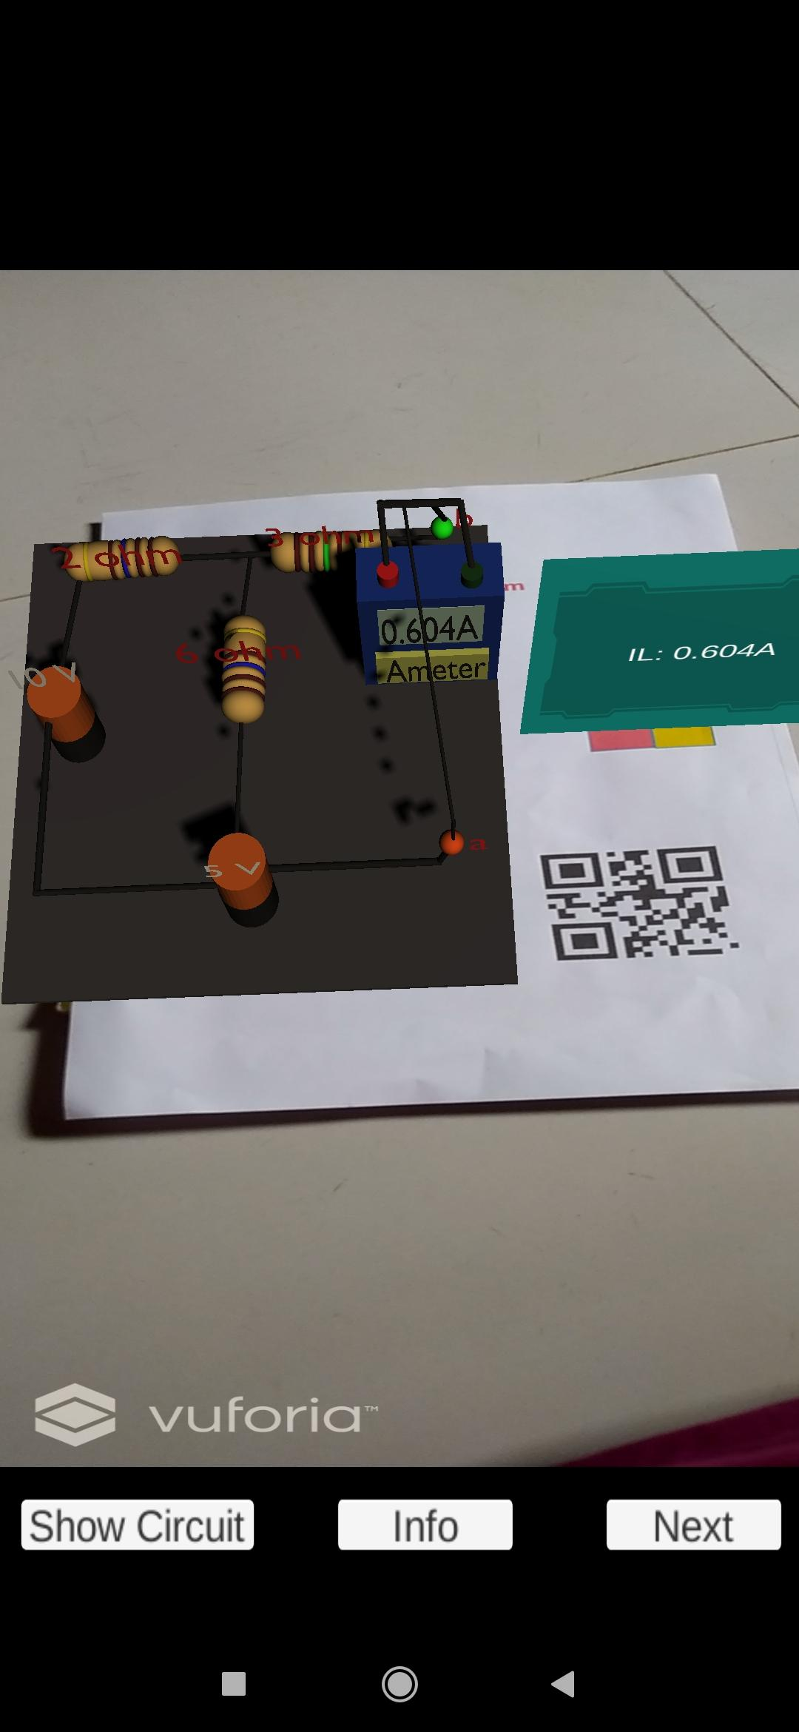
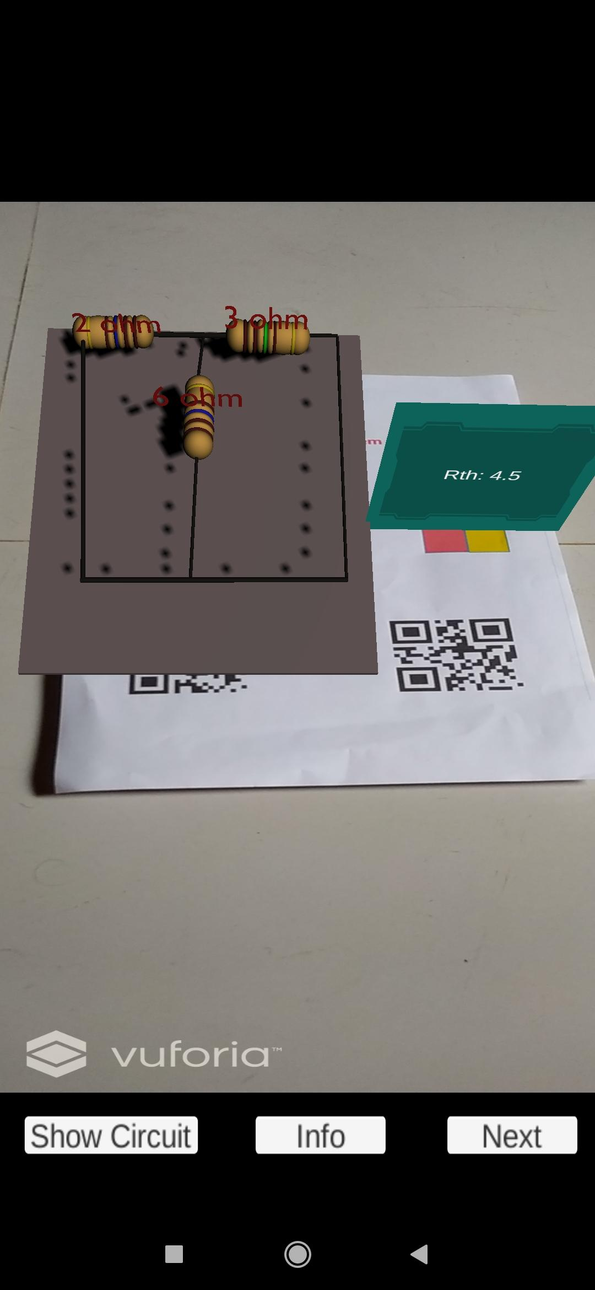
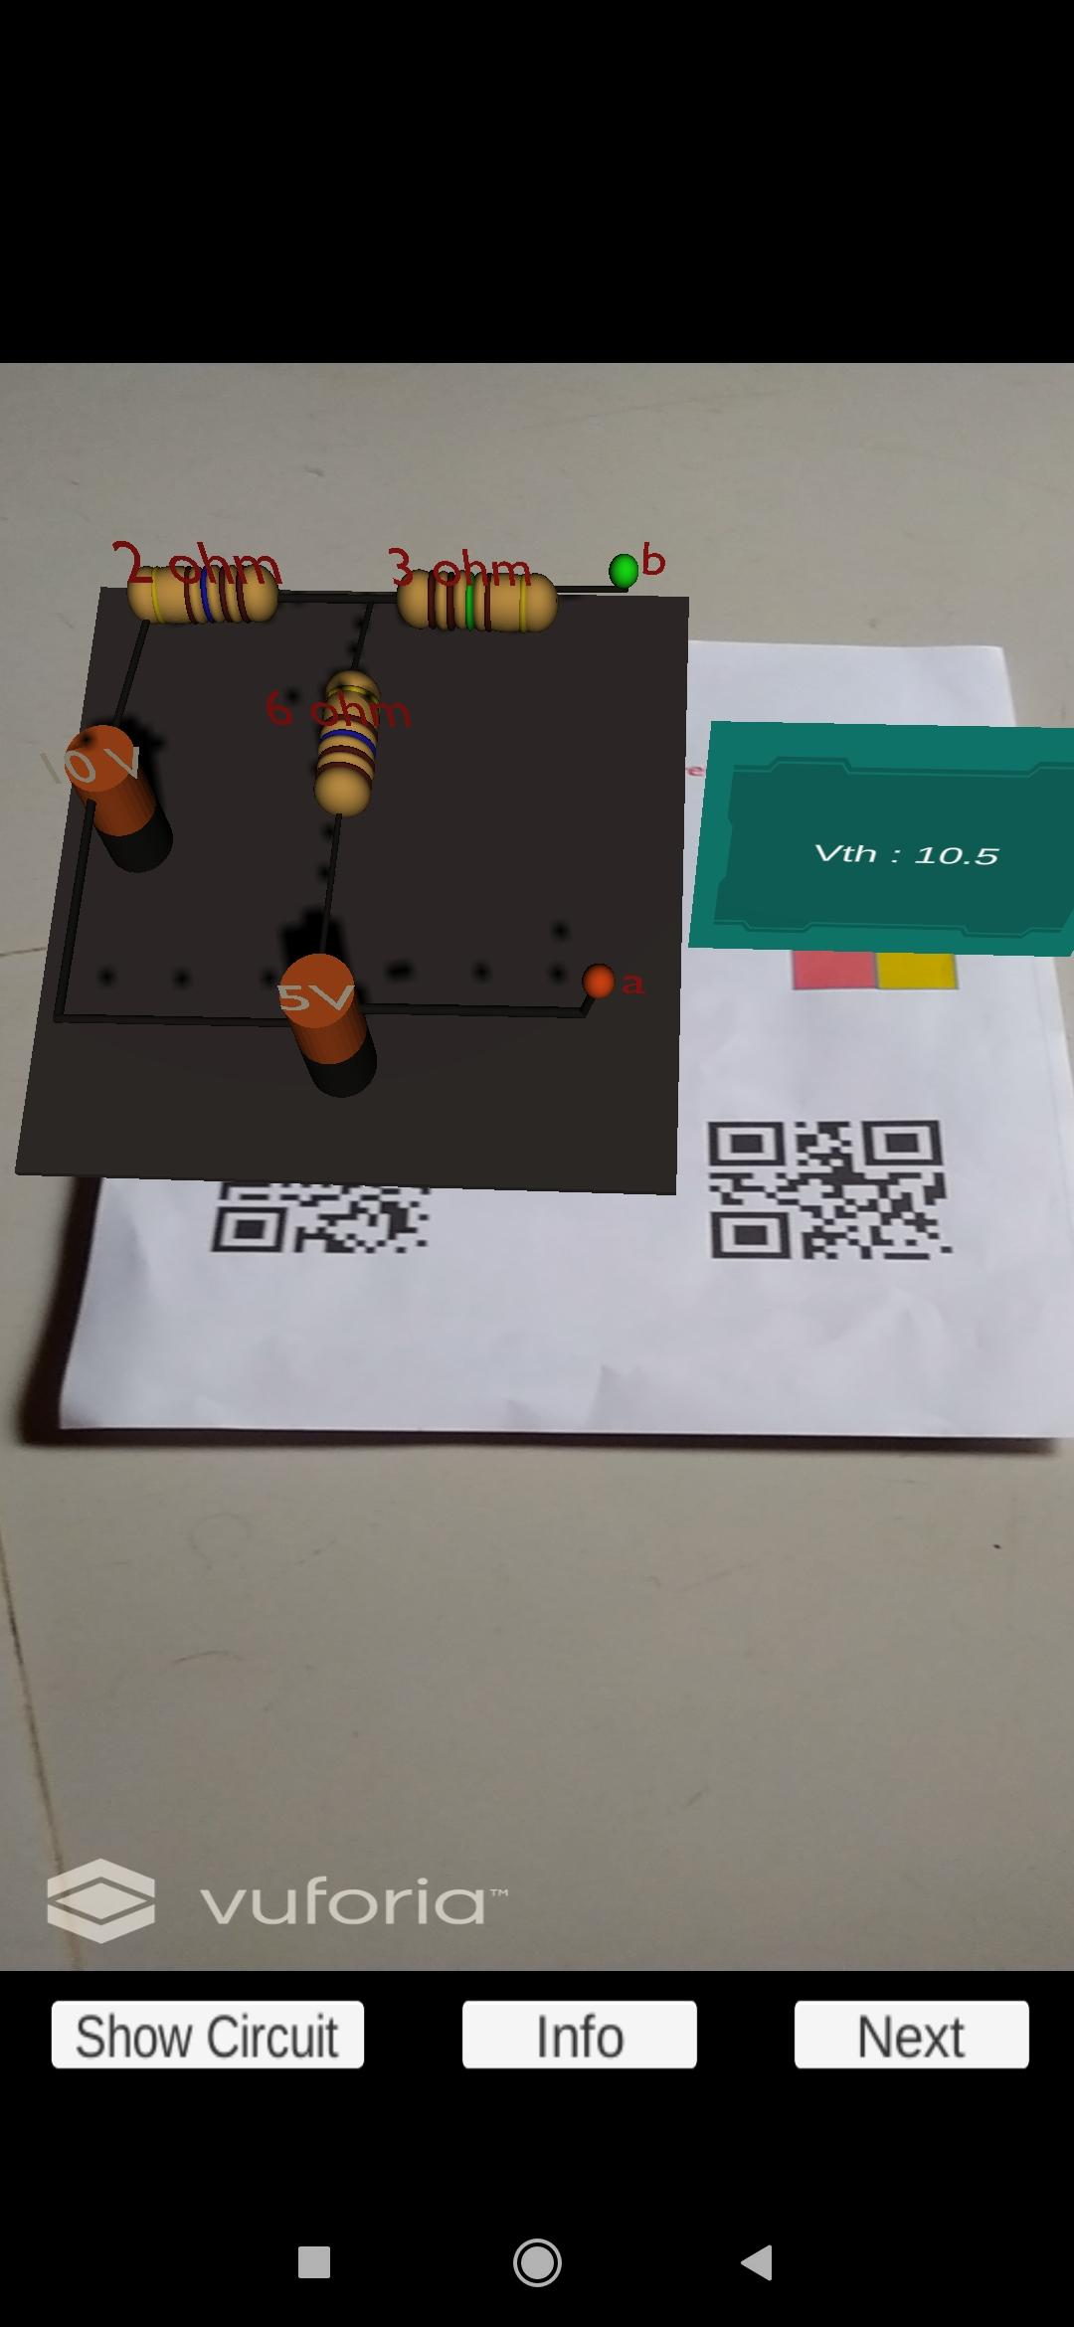
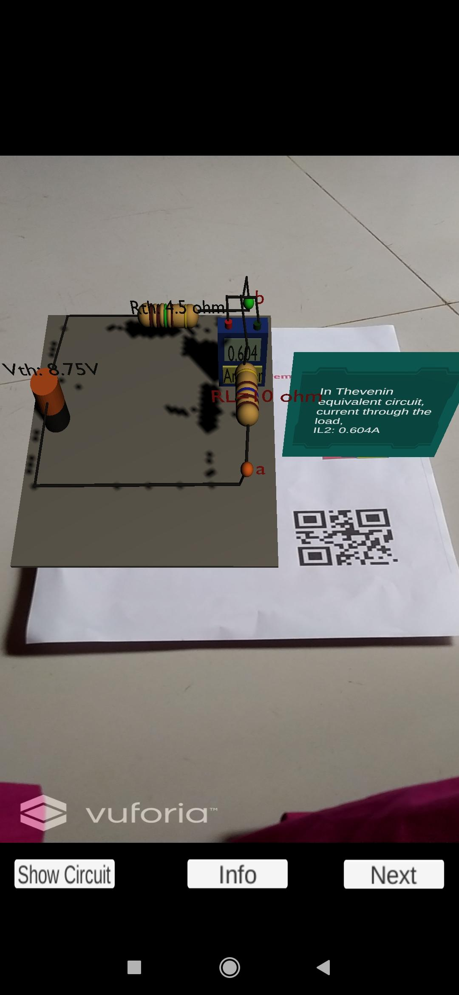
View of experiment 1 of Thevenin’s Theorem

Slide 44
Norton’s Theorem
Users can choose either batteries of 10V and 5V or 12V and 6V.
For resistors, there are two options for users, R1=10Ω, R2=10Ω and R3=5Ω or R1=3Ω, R2=6Ω and R3=3Ω.
Table 4 verifies Norton’s theorem.
Table 4: Table verifying Norton's Theorem
Experiment No. | V1 | V2 | R1 | R2 | R3 | I1 | Rn | In | I2 (Norton circuit)
1 | 10V | 5V | 10Ω | 10Ω | 5Ω | 0.375A | 10Ω | 0.75A | 0.375A
2 | 10V | 5V | 3Ω | 3Ω | 6Ω | 0.604A | 4.5Ω | 0.625A | 0.604A
3 | 12V | 6V | 3Ω | 3Ω | 6Ω | 0.724A | 4.5Ω | 0.75A | 0.724A
4 | 12V | 6V | 10Ω | 10Ω | 5Ω | 0.45A | 10Ω | 0.3A | 0.45A
45

Slide 45
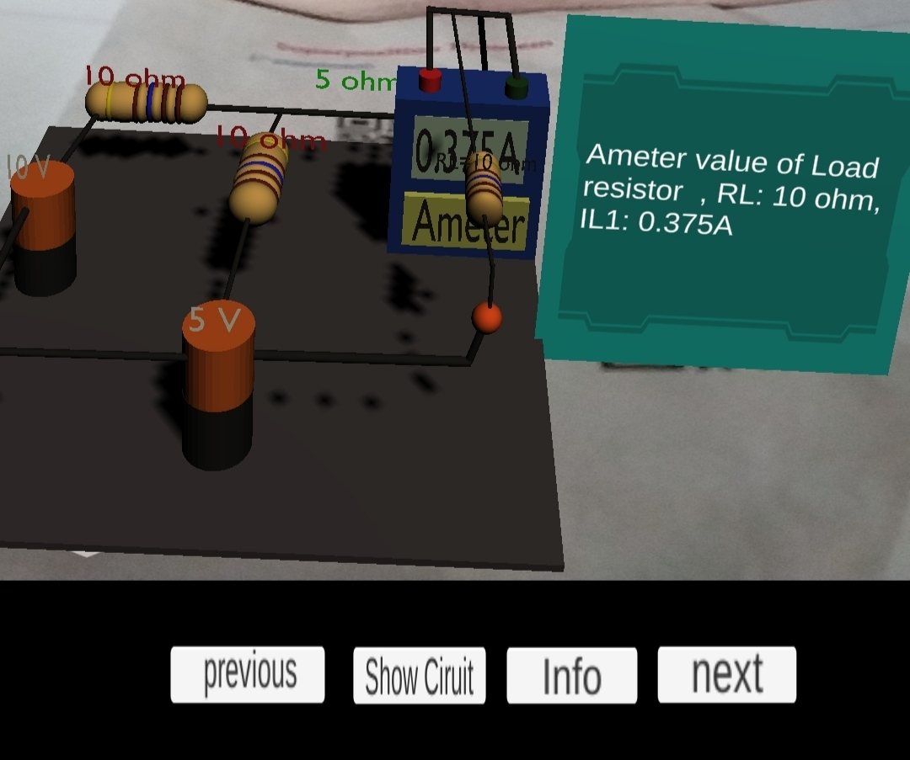
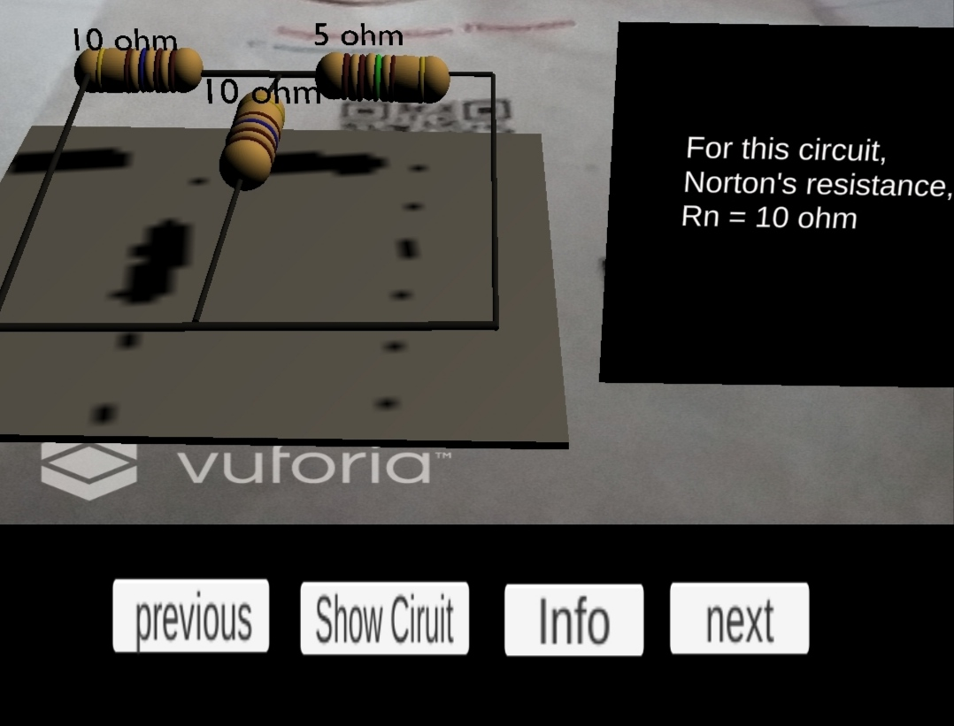
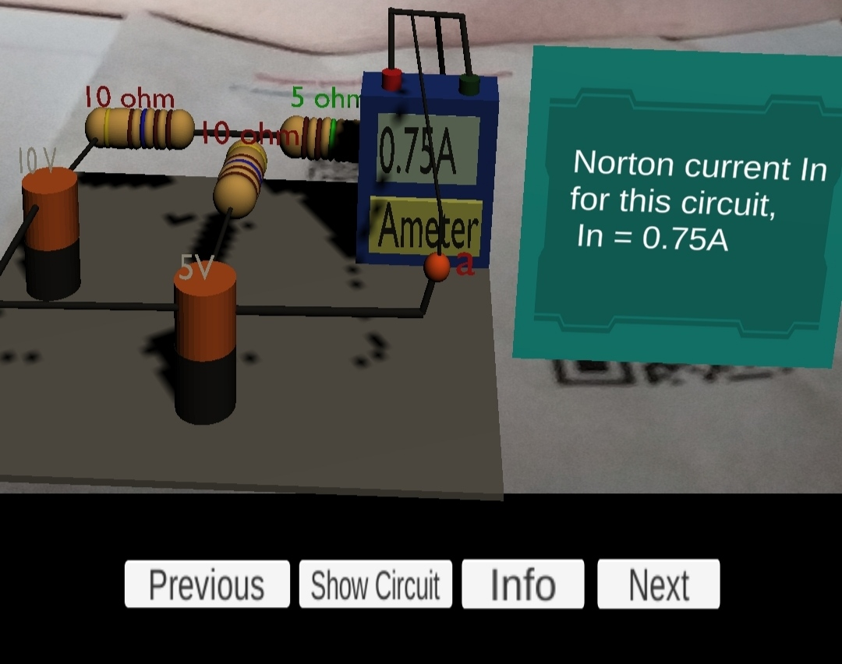
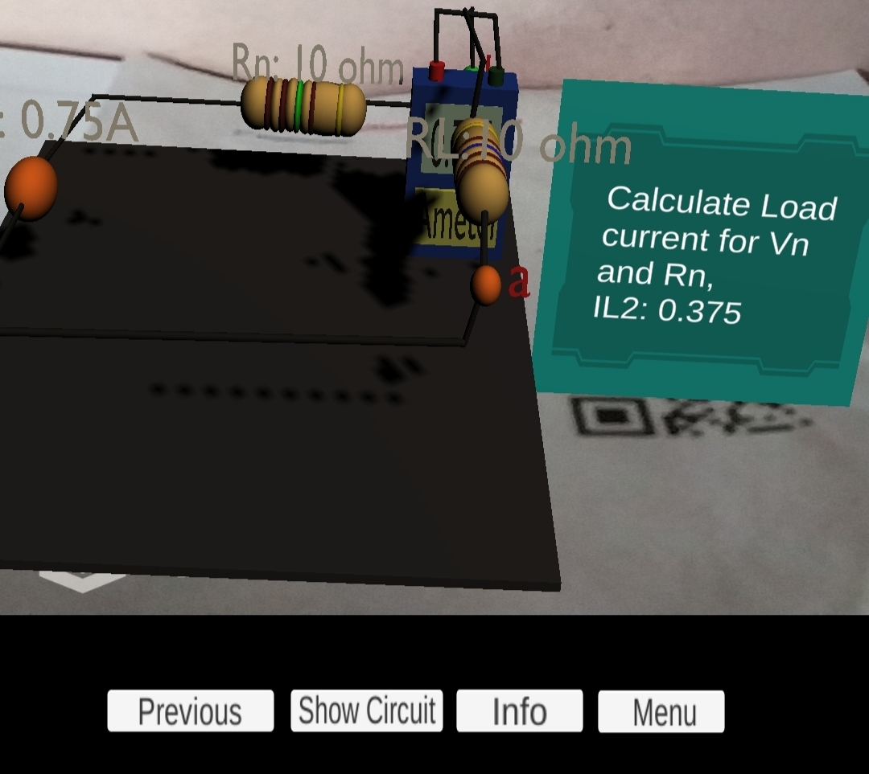
View of experiment 1 of Norton's Theorem

Slide 46
Reciprocity Theorem
Table 6: data table for verifying Reciprocity theorem.
Users can choose either batteries of 10V or 7V.
For resistors, there are two options for users, R1=5Ω, R2=6Ω and R3=7Ω ohm or R1=3Ω, R2=6Ω and R3=3Ω.
Table 6 verifies Reciprocity theorem.
Experiment No. | V | R1 | R2 | R3 | I1 ( Before interchange) | I2 (After interchange)
1 | 10V | 5Ω | 6Ω | 7Ω | 0.56A | 0.56A
2 | 10V | 3Ω | 3Ω | 6Ω | 1.00A | 1.00A
3 | 7V | 3Ω | 3Ω | 6Ω | 0.39A | 0.39A
4 | 7V | 10Ω | 10Ω | 5Ω | 0.7A | 0.7A

Slide 47
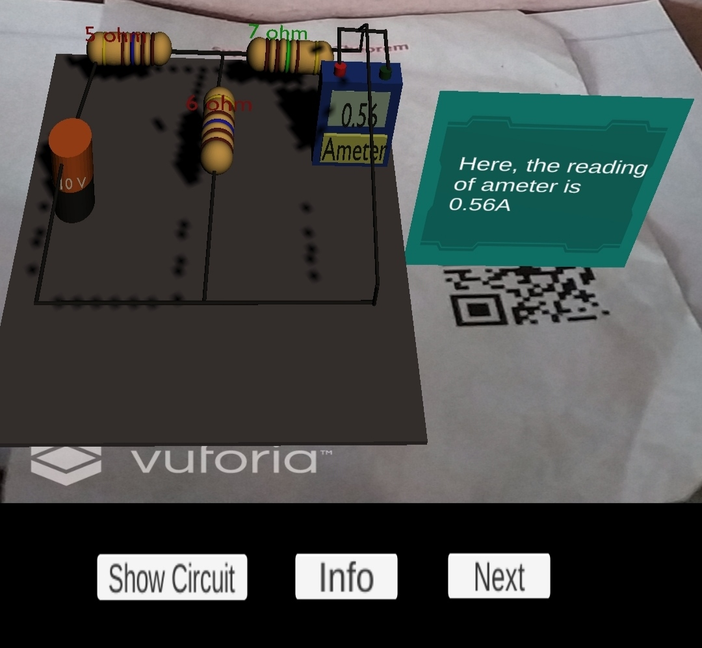
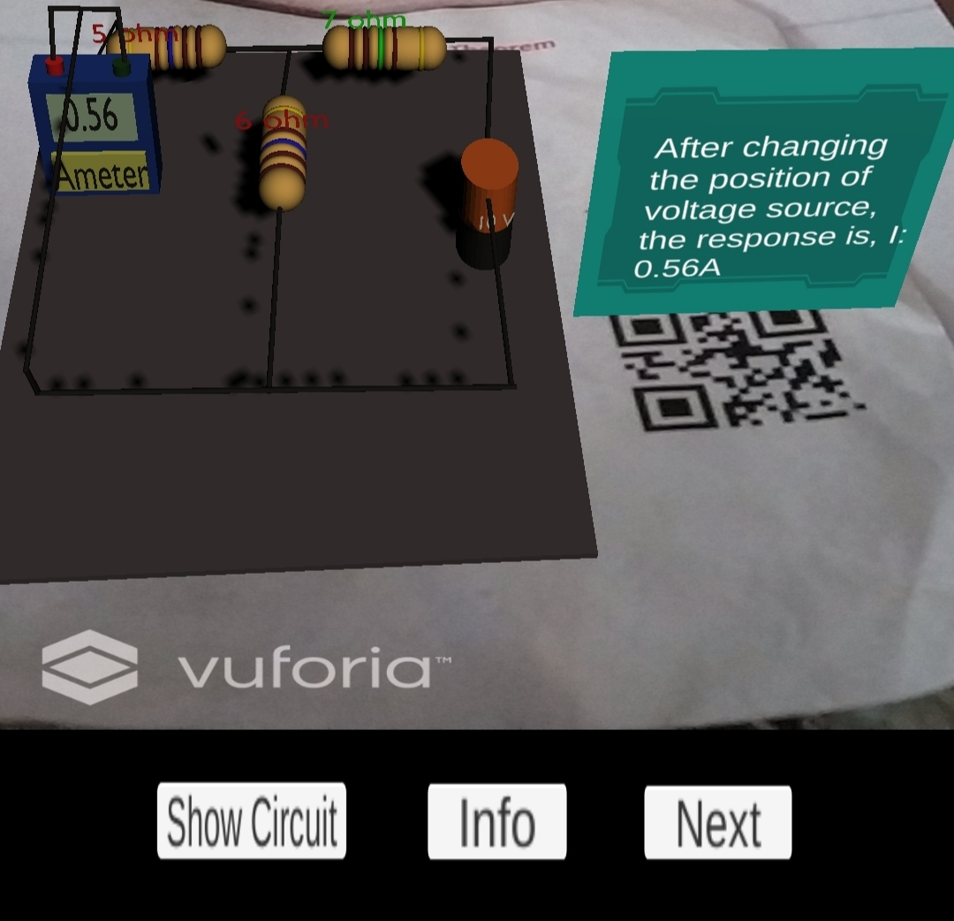
View during the experiment 1 of Reciprocity theorem

Slide 48
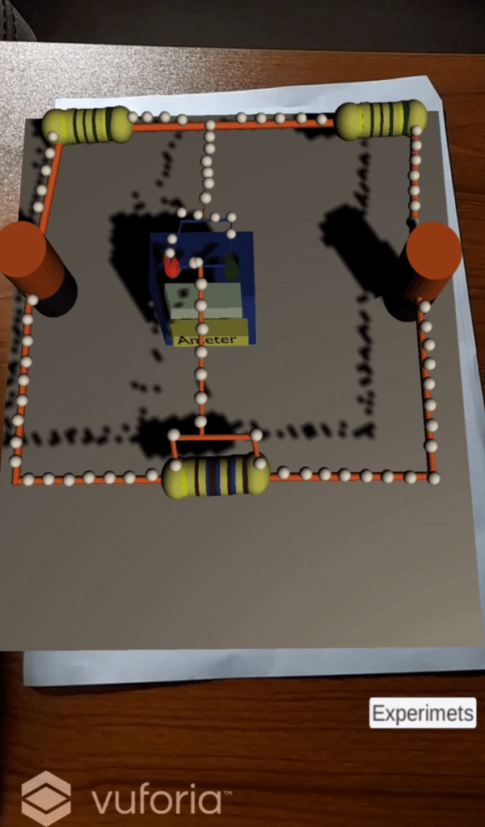
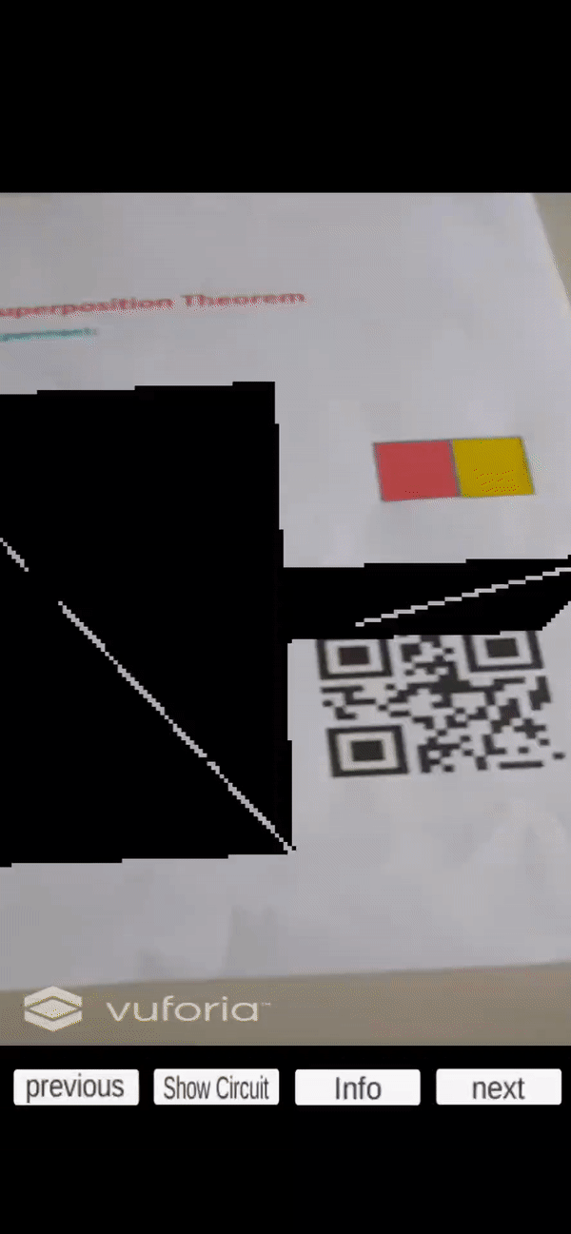
Animation

Slide 49
CONCLUSION
Presented virtual circuits can be called digital magnifying glass for students to look inside electrical systems.
Five basic theorem of electrical engineering can be learnt using this single application.
Students can have laboratory-like learning experience without being present in the laboratory.
3D models used in this application are reusable.
This application is easy to install, needs no internet connection.
Implementing this project in education will not only make learning fun, interactive, accessible but also reduce cost and complexity.

Slide 50
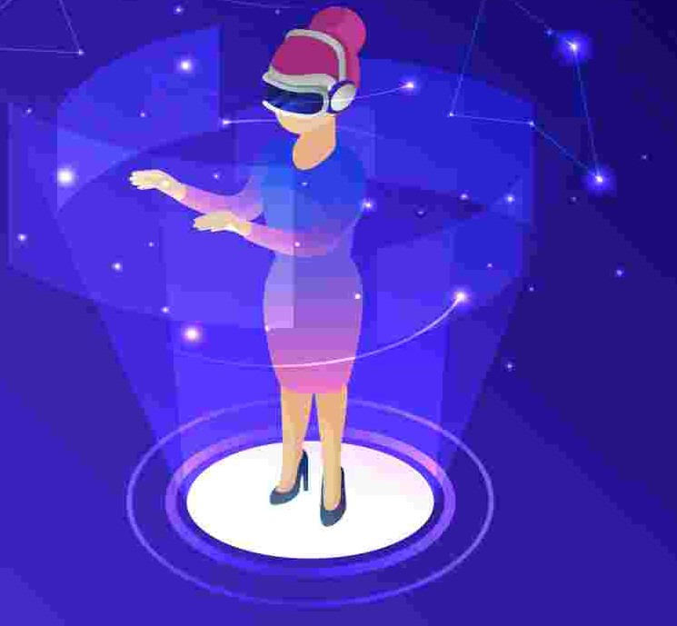
FUTURE SCOPES
Many complex topics such as microwave engineering, optical fiber, satellite communication, digital signal processing etc. can be made easy and understandable using AR.
Steps can be taken to develop virtual labs to use before relevant real laboratory experiments.
Other hardware devices, like projector, AR base head mounted display can be used for this project which will give the students more lively experience.

Slide 51
REFERENCES
Hovhannes Mayilyan, "Implementation of Augmented Reality Globe in Teaching-Learning Environment", IEEE Conference on Multimedia Information Processing and Retrieval (MIPR), 2019.
P. Chen, X. Liu, W. Cheng and R. Huang, ‘‘A review of using Augmented Reality in Education from 2011 to 2016,’’ Lecture Notes in Educational Technology, Springer Science+Business Media, 2017.
Antonio Cazzolla, Rosa Lanzilotti, Teresa Roselli, Veronica Rossano, "Augmented Reality to support education in Industry 4.0," 18th International Conference on Information Technology Based Higher Education and Training (ITHET), 2019.
Malek El Kouzi, Abdihakim Mao, Diego Zambran0, "An Educational Augmented Reality Application for Elementary School Students Focusing on the Human Skeletal System," IEEE Conference on Virtual Reality and 3D User Interfaces (VR), 2019.

Slide 52
Any question?
Thank You

